Slide 1
Spring Boot Series – Day 3
Topic: Spring Boot Annotations (Part 1)
@CodeByHaindavi | #SpringWithMe

Slide 2
Spring Boot Annotations – Why They Matter
✔️ In earlier Spring projects, setting things up meant dealing with bulky XML files — even a simple connection between two classes needed manual configuration.
✔️ Spring Boot made this easier with annotations like @Service or @RestController. Just by tagging the class, the framework figures out how everything fits together.
✔️ No external wiring, no guesswork — just clean code that declares intent directly.
✔️ It’s like moving from manual wiring to smart plugs — plug it in, and Spring knows what to do.
@CodeByHaindavi | #SpringWithMe

Slide 3
Why Spring Boot Favors Annotation-Driven Setup
✔️ Configuration stays close to the code – no need to manage separate XML files. Annotations make the intent immediately visible. ✔️ Automatic detection and setup – Spring Boot scans annotated classes and wires everything without manual steps. ✔️ Easier to read, debug, and scale – cleaner structure helps teams navigate and grow codebases faster. ✔️ Annotation-first design – many key Spring Boot features (like REST APIs, Data JPA, Security) rely entirely on annotations to work.
@CodeByHaindavi | #SpringWithMe

Slide 4
@SpringBootApplication – The Power Combo
Used on the main class to tell Spring: “This is the starting point.” ✔️ Internally bundles three important annotations:
@Configuration – Marks the class as a source of Spring beans.
@ComponentScan – Scans the package for other annotated components.
@EnableAutoConfiguration – Auto-configures dependencies based on the classpath.
✔️ This single annotation replaces multiple setup lines — making project bootstrapping quick and clean.
It’s the first thing every Spring Boot app needs — and it silently does a lot of heavy lifting behind the scenes.
@CodeByHaindavi | #SpringWithMe

Slide 5
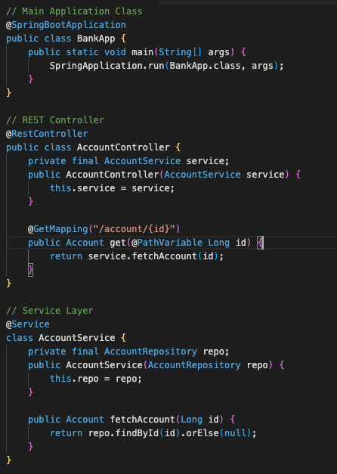
Spring Boot Wiring: A Real Example
✔️ Spring Boot begins with @SpringBootApplication, which tells the framework to scan and wire everything automatically. ✔️ In this example, the controller receives a request, the service handles the logic, and the repository fetches the data — all connected through annotations. ✔️ This structure keeps the code clean, modular, and ready to scale — no XML or manual configuration needed.
@CodeByHaindavi | #SpringWithMe

Slide 6
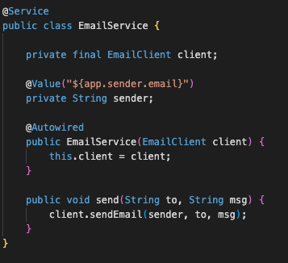
Wiring Dependencies with @Autowired and @Value
✔️ @Autowired helps inject required dependencies (like services or repositories) — Spring takes care of object creation behind the scenes. ✔️ It works best with constructor injection — it’s cleaner, testable, and preferred in real-world projects. ✔️ @Value lets you read values from the application.properties file — ideal for injecting configs like API keys, DB URLs, or timeouts.
@CodeByHaindavi | #SpringWithMe

Slide 7
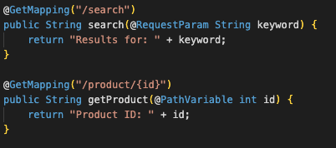
Handling Request Data - @RequestParam, @PathVariable
✔️ @RequestParam is used to capture query parameters from the URL. It’s useful when you want to filter, search, or paginate using values like ?category=shoes.
✔️ @PathVariable extracts values embedded in the URL path itself. It’s used when identifying specific resources like /products/12.
Both help you build clean, readable endpoints without extra parsing logic.
@CodeByHaindavi | #SpringWithMe

Slide 8
💼 Interview Insight
How does Spring Boot internally detect and manage annotated components like @Service or @RestController?
• Spring Boot uses @ComponentScan (enabled by @SpringBootApplication) to automatically scan classes with stereotype annotations and register them as beans. • Behind the scenes, it builds a context by detecting these beans at startup and wires them using dependency injection — no manual config needed.
What is the difference between using @Autowired and constructor injection?
• Constructor injection is cleaner and makes dependencies explicit — it works even without @Autowired if there’s only one constructor. • It improves testability and avoids issues like circular or hidden dependencies that often occur with field injection.
@CodeByHaindavi | #SpringWithMe

Slide 9
📌 Hands-On Tip
✔️ Open any of your Spring Boot projects and identify where @Controller, @Service, and @Repository are used — understand how Spring wires them.
✔️ Remove one annotation at a time and observe what breaks — this helps you understand their exact role.
@CodeByHaindavi | #SpringWithMe

Slide 10
📌 Recap – Day 2
✔️ Instead of wiring everything manually, we just tag our classes — and Spring handles the rest. ✔️ That one annotation on the main class (@SpringBootApplication) quietly sets up scanning, config, and auto-wiring for us. ✔️ We also looked at how @Controller, @Service, and @Repository shape the flow of any project. ✔️ And if you’ve been using @Autowired everywhere — now you know why constructor injection is a cleaner choice.
👉 Coming up next: Spring Boot Annotations – Part 2✨
@CodeByHaindavi | #SpringWithMe

